Slide 1
Recursion
Lecture-8
Understanding Recursion
Problems on Recursion
Merge Sort
Kartik Mathur

Slide 2
Call Stack!

Slide 3
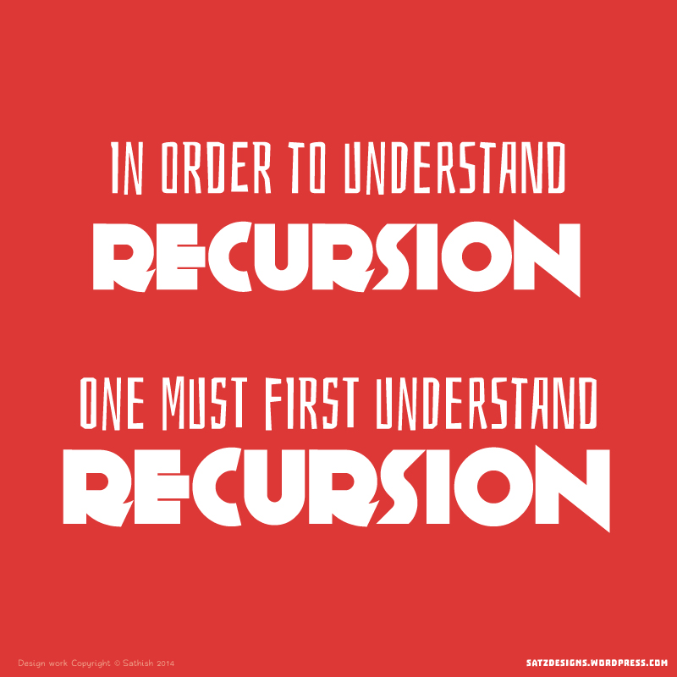
How to understand Recursion ?
Notes:
Factorial
Talk about mathematical induction

Slide 4
Time to talk about Recursion!

Slide 5
What is Recursion?
Recursion in computer science is a method
where the solution to a problem depends on
solutions to smaller instances of the same
Problem.

Slide 6
Parts of Recursive Algorithm
Base Case (i.e., when to stop)
Work toward Base Case
Recursive Call (i.e., call ourselves)
The "work toward base case" is where we make the problem simpler. The recursive call, is where we use the same algorithm to solve a simpler version of the problem. The base case is the solution to the "simplest" possible problem

Slide 7
Print Factorial of N
What is the recursive call?
What is the base case?
Notes:
Use cout statement to explain call stack and the values of local variables created during the call stack.
Int factorial(int n) {
cout << “Enter factorial function with n = “ << n << endl;
if ( n == 0) {
cout << “Exiting Factorial function with n = “ << 0 << endl;
return 0;
}
int ans = n * factorial(n-1);
cout << “Factorial(“ << n << “) = “ << ans;
return ans;
}

Slide 8
Print Nth Fibonacci Number
What is the recursive call?
Base Case?
Notes:
Have input/output statements and ask students to write output. Give them atleast 5 mins.
int fibo(int n) {
cout << “Entering fibo function with value n = “ << n << endl;
if (n == 0) {
cout << “Exiting Fibo function with value n = “ << 0 << endl;
return 0;
}
if (n == 1) {
cout << “Exiting Fibo function with value n = “ << 0 << endl;
return 1;
}
int ans = fibo(n-1) + fibo(n-2);
cout << “ Fibo(“ << n <<“) = “ << ans << endl;
return ans;
}

Slide 9
Behind the scenes!

Slide 10
Check if an array is sorted
What is the recursive call?
Base Case?
Notes:
Have input/output statements and ask students to write output. Give them atleast 5 mins.
int fibo(int n) {
cout << “Entering fibo function with value n = “ << n << endl;
if (n == 0) {
cout << “Exiting Fibo function with value n = “ << 0 << endl;
return 0;
}
if (n == 1) {
cout << “Exiting Fibo function with value n = “ << 0 << endl;
return 1;
}
int ans = fibo(n-1) + fibo(n-2);
cout << “ Fibo(“ << n <<“) = “ << ans << endl;
return ans;
}

Slide 11
Lets code some more problems
Sum of Array
Print Numbers –
1) Increasing Order
2) Decreasing Order

Slide 12
Your Turn
Write code for a function power(x,n) which evaluates x^n.
Given an integer say –
2048 , print “two zero four eight” using recursion.
Given an array
Check if it contains 7
Find first index of 7
Find last index of 7
Find all indices of 7

Slide 13
Time to try?
Multiply two numbers using recursion
Bubble Sort using recursion.
Binary Search using recursion.
Convert a String into Integer using recursion.

Slide 14
Merge Sort!

Slide 15
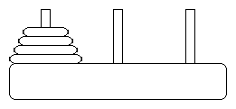
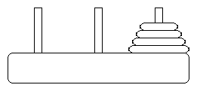
Tower Of Hanoi?

Slide 16
What is next class about?
More into recursion.

Slide 17
Thank You!
Kartik Mathur

